Slide 1

Aim Games Platform
The reference platform for game-making resources
Group 7
Speaker: Mario Bizcocho González

Slide 2
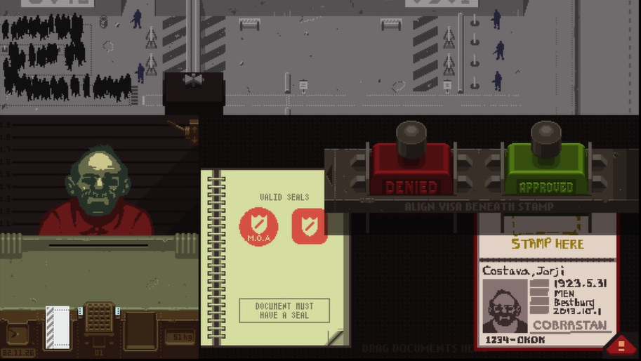
Papers, Please (Lukas Pope, 2013)

Slide 3
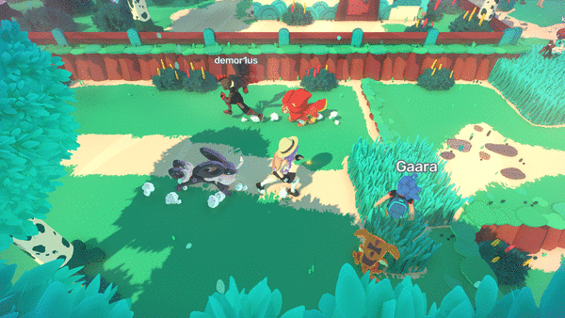
TemTem (CremaGames, 2019)

Slide 4
450 incorporated studios
Spain, 2017 (AEVI Yearly Report)
+620 unincorporated (estimate, Devuego) =
1070 national studios

Slide 5
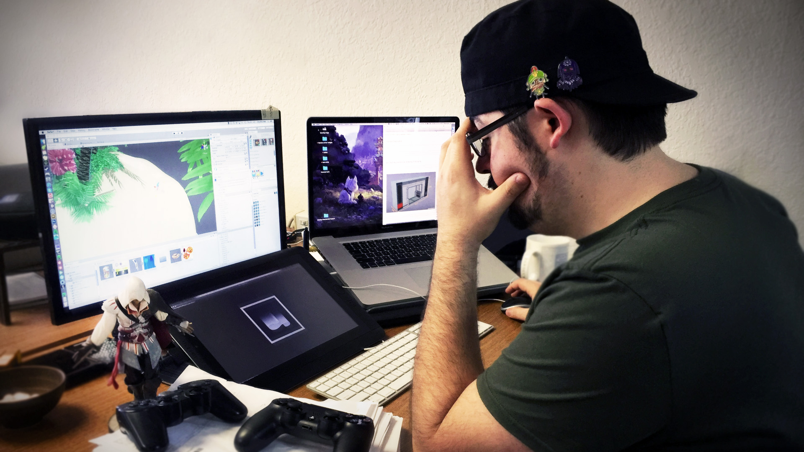
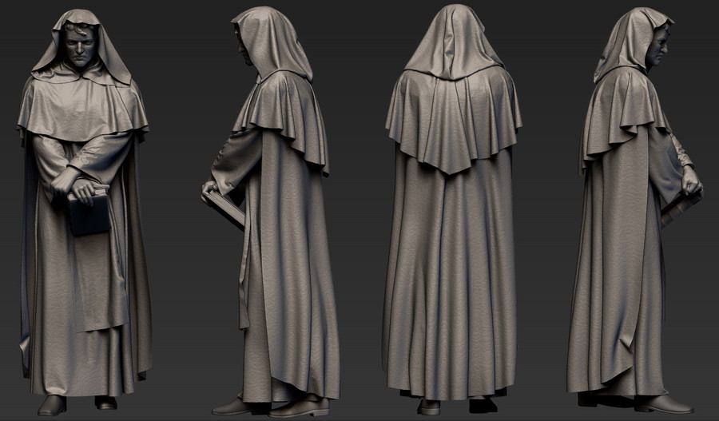
What do they need?

Slide 6
Contents
What is Aim Games?
Demonstration
Where we are
Team composition
Productivity control
Next steps

Slide 7
Contents
What is Aim Games?
Demonstration
Where we are
Team composition
Productivity control
Next steps

Slide 8
What is Aim Games?
Andalusian Association for the Promotion of Videogames
Provides human and technological resources
Includes experienced professionals

Slide 9
How are we making money?
Government aids
Company membership fees
Sublicensing administrative Access
Development events

Slide 10
Competitor analysis
 | AIM Games | Linkedin | Infojobs | Stratos | Icaro | Primerempleo | Jobrapido | Trabajos.com | Ibereoempleos
Forum | ✓ | ❌ | ❌ | ✓ | ❌ | ❌ | ❌ | ❌ | ❌
Verify CV | ✓ | ❌ | ❌ | ❌ | ❌ | ❌ | ❌ | ❌ | ❌
Share Resources | ✓ | ❌ | ❌ | ✓ | ❌ | ❌ | ❌ | ❌ | ❌
Direct Messaging | ✓ | ✓ | ❌ | ❌ | ❌ | ❌ | ❌ | ❌ | ❌
Courses | ✓ | ✓ | ✓ | ✓ | ❌ | ✓ | ❌ | ✓ | ✓
Company profiles | ✓ | ❌ | ✓ | ✓ | ✓ | ✓ | € | € | ✓
Sector specific | ✓ | ❌ | ❌ | ✓ | ❌ | ❌ | ❌ | ❌ | ❌
Organises events | ✓ | ❌ | ❌ | ❌ | ❌ | ❌ | ❌ | ❌ | ❌
Notes:
AEVI: Asociación Española del Videojuego
STRATOS: offers both job opportunities and collaboration opportunities, the latter do not necessarily involve economical retribution. Also, severe lack of offers in Andalusia. Resembles a forum.
ICARO insecure: GET hacking when editing curricula

Slide 11
Differentiation
Intuitive design
Credibility
Proximity
Collaboration

Slide 12
Contents
What is Aim Games?
Demonstration
Where we are
Team composition
Productivity control
Next steps

Slide 13
Contents
What is Aim Games?
Demonstration
Where we are
Team composition
Productivity control
Next steps

Slide 14
Where we are
Core use cases completed
Retrospective: good development cycle overall
Issues handled effectively

Slide 15
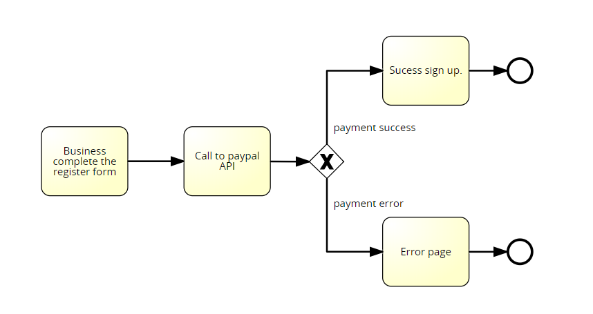
Where we are
Issue 1: PayPal

Slide 16

Where we are
Issue 2: Database population

Slide 17

Where we are
Issue 3: Git management

Slide 18
Where we are
Concept | Net cost
Direct costs (salaries, social costs, others) | €32258.01
Indirect costs | €322.58
Reserves | €3258.06
Profit | €4887.09
Total before tax | €40725.74
VAT (21%) | €8552.41
Total | €49278.15
Notes:
Capital revenue: regional government aids to associations, company membership fees,

Slide 19
Where we are
Name | Role | Price/hour | Invested hours | Gross Salary | Social costs | Total
De la Fuente Bonilla, Fco. Javier | CEO, Project Manager | 25€/h | 150h | 3750€ | 1124.63€ | 4874.63€
Molina Domínguez, Jorge Manuel | CCO, CIO | 22,73€/h | 150h | 3409,5€ | 1022.51€ | 4432.01€
Bizcocho González, Mario | CMO, Speaker | 22,73€/h | 150h | 3409,5€ | 1022.51€ | 4432.01€
Monteseirín Puig, Alejandro | Full-stack Developer | 18,54€/h | 150h | 2781€ | 834.03€ | 3615.03€
Pérez Piñero, Iván | Backend Developer | 15,37€/h | 150h | 2305.5€ | 689.35€ | 2994.85€
Arenas Arenas, Antonio | Frontend Developer | 15,37€/h | 150h | 2305.5€ | 689.35€ | 2994.85€
Santos Batista, Miguel | Full-stack Developer | 18,54€/h | 150h | 2781€ | 834.03€ | 3615.03€
Pazo Jiménez, Pablo | Backend Developer | 15,37€/h | 150h | 2305.5€ | 689.35€ | 2994.85€
 |  |  |  | 23047,5€ | 6905.76€ | 29953,75€
Notes:
Capital revenue: regional government aids to associations, company membership fees,

Slide 20
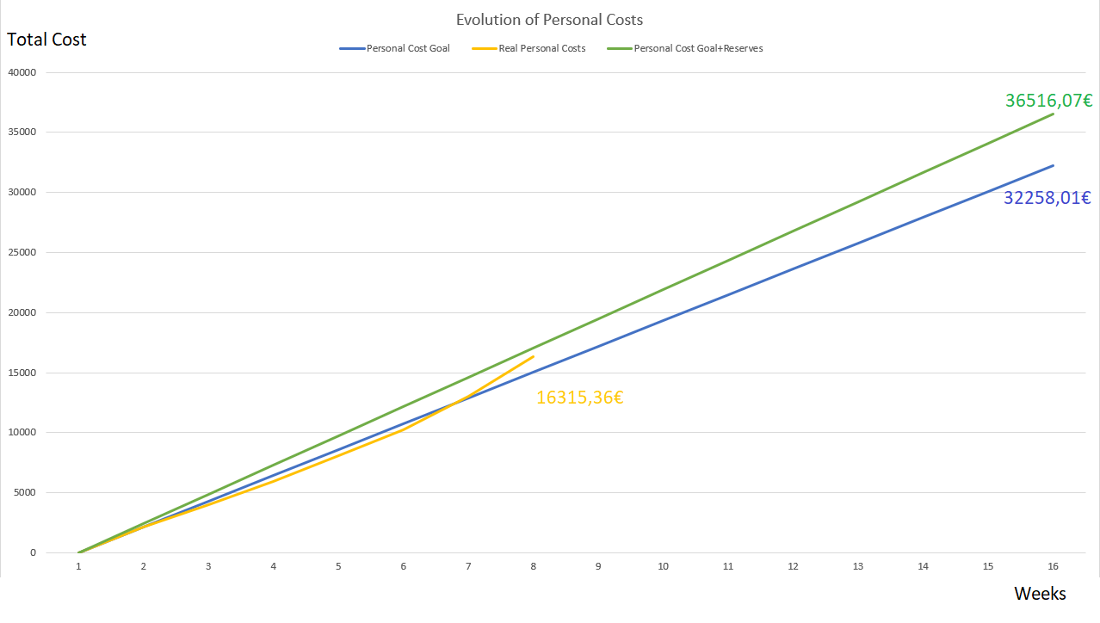
Where we are

Slide 21
Contents
What is Aim Games?
Demonstration
Where we are
Team composition
Productivity control
Next steps

Slide 22
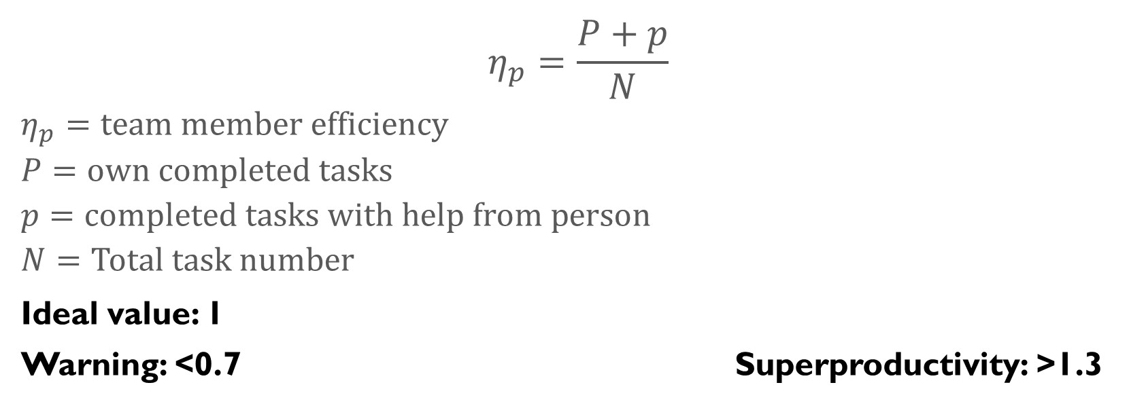
Productivity plan
$$η_{p}=\frac{P+p}{N}$$
$$η_{p}=team member efficiency$$
$$P=own completed tasks$$
$$p=completed tasks with help from person$$
$$N=Total task number$$
Ideal value: 1
Warning: <0.7 Superproductivity: >1.3

Slide 23
Punishment strategy
3 warning system
Expulsion at the 3rd warning
Automatic warning for incompletion
Proposed warning (voting)
Pardoning of warning on sprint without incidents

Slide 24
Contents
What is Aim Games?
Demonstration
Where we are
Team composition
Productivity control
Next steps

Slide 25
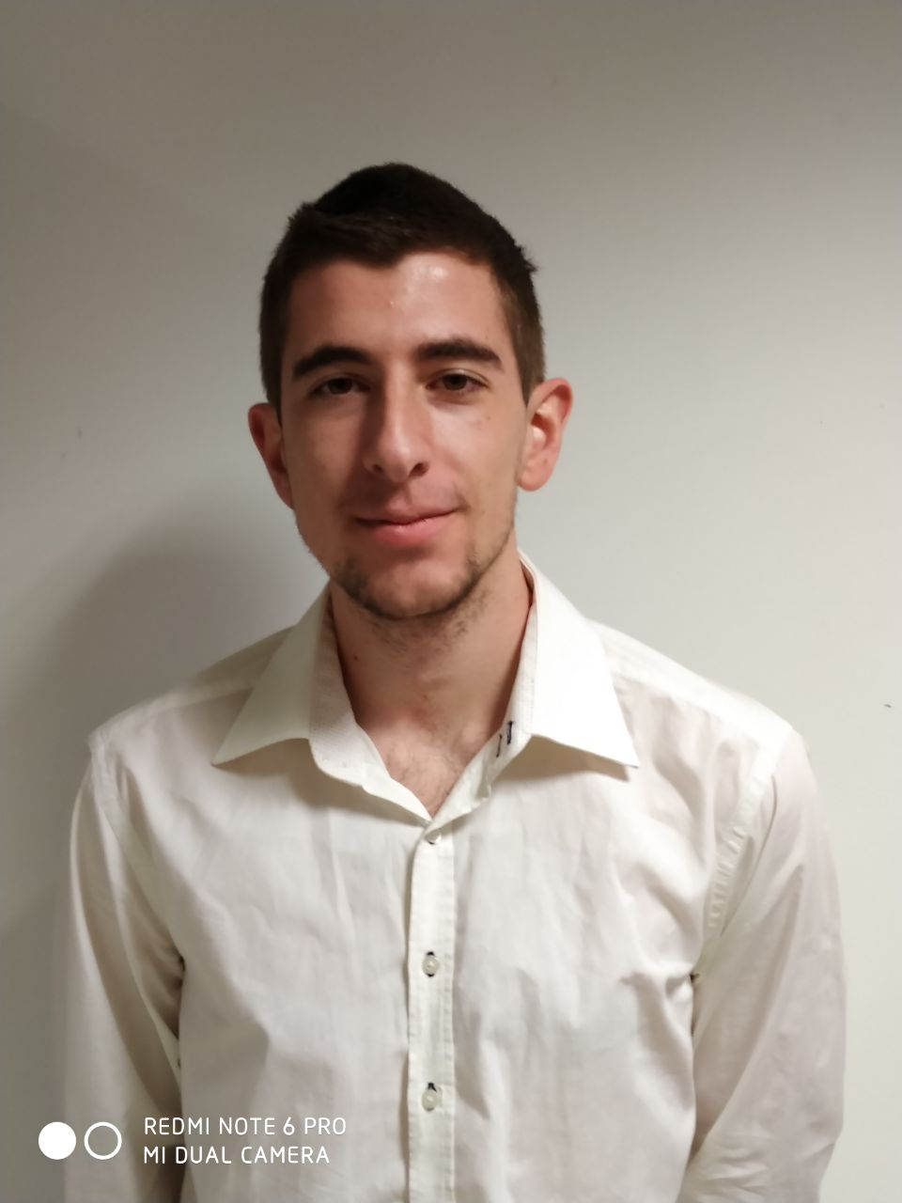
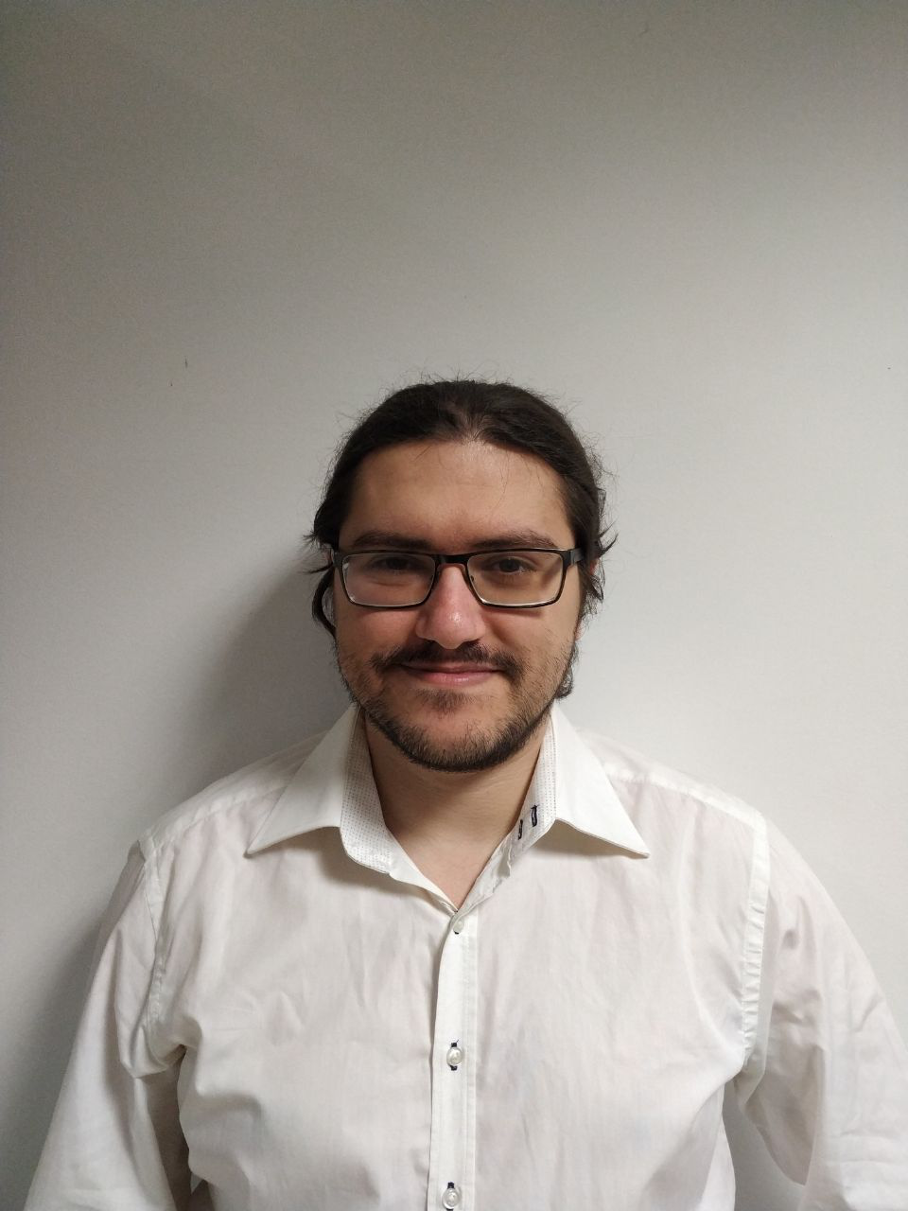
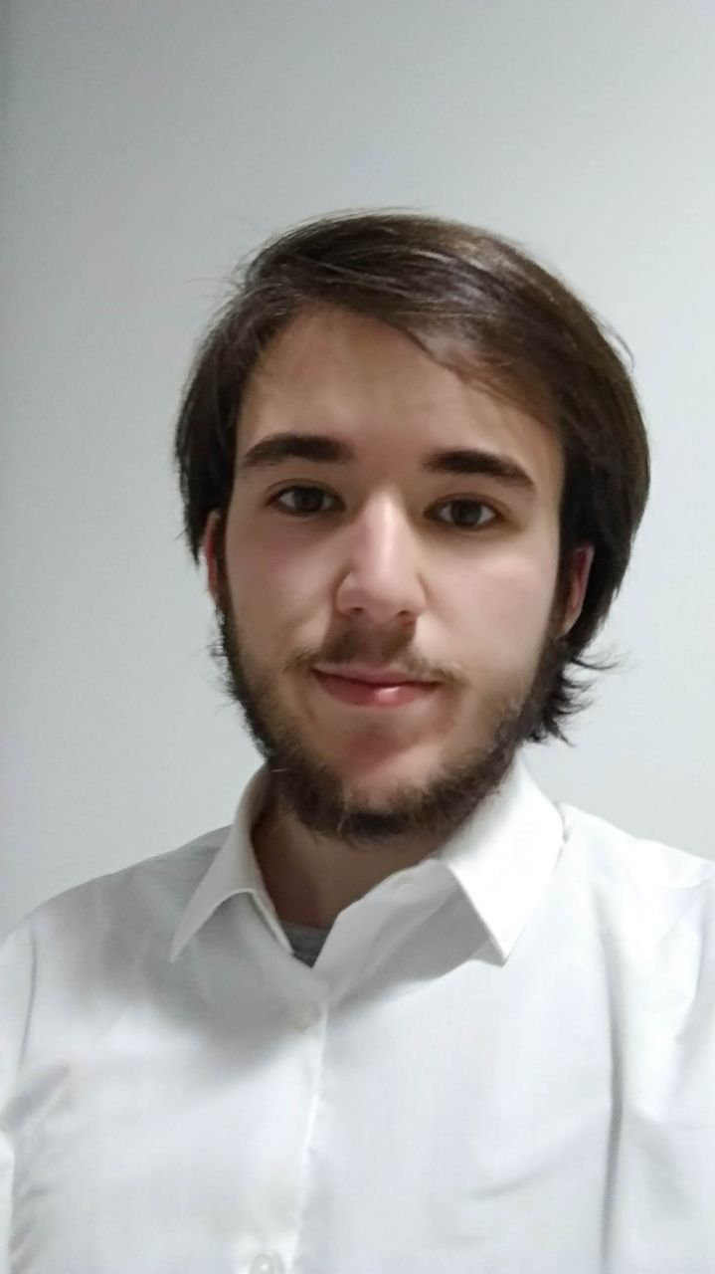
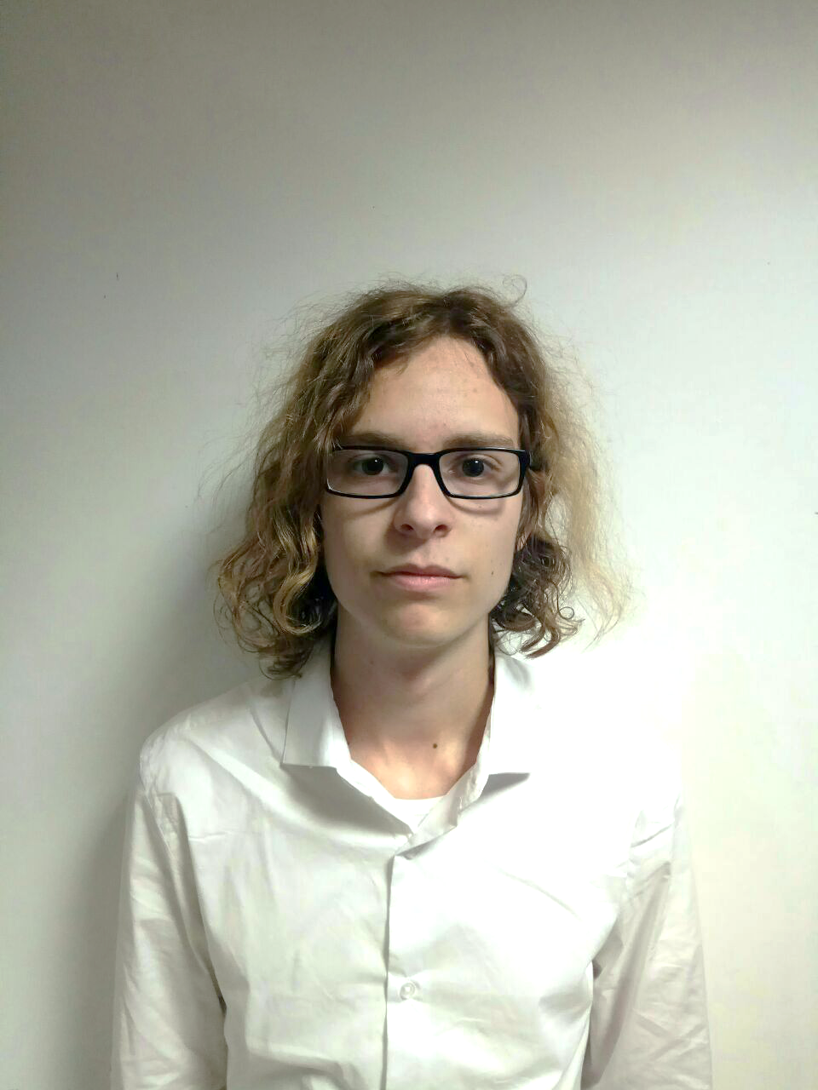


Team composition
Fco. Javier de la Fuente Bonilla | Jorge Manuel Molina Domínguez | Mario Bizcocho González | Alejandro Monteseirín Puig
Project manager, CEO | CCO, CIO | Speaker, CMO | Full-stack developer
1.6
1
2
1.6
24.5
/
23
18.5
/
18.5
(h)
21
/
21
24
/
24
Notes:
Grupo 7

Slide 26
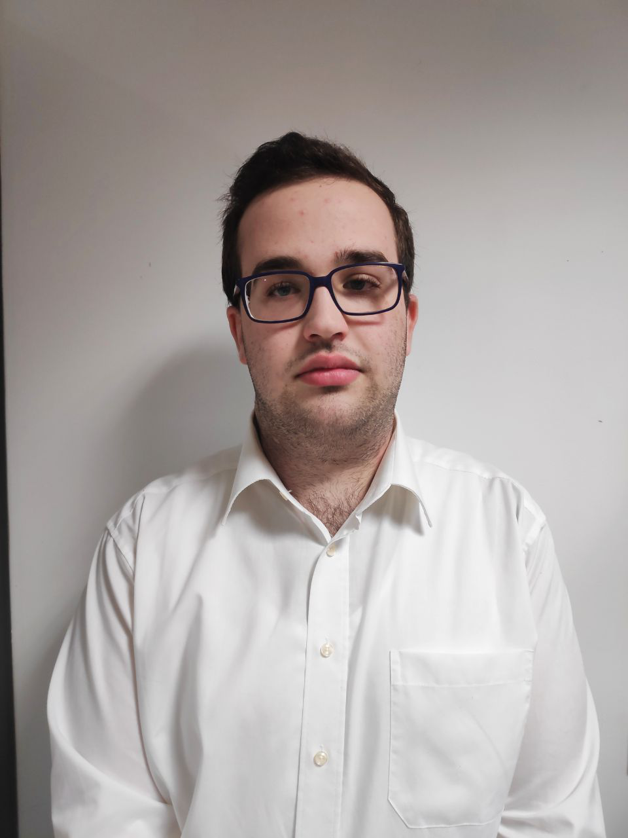
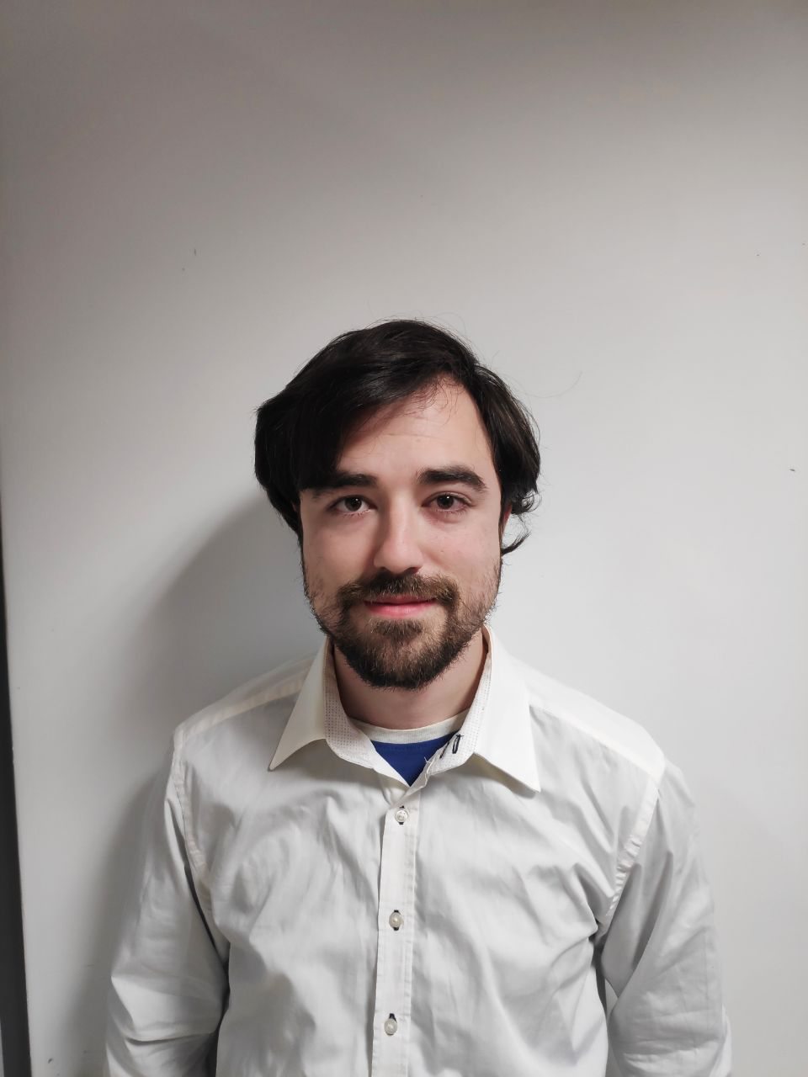
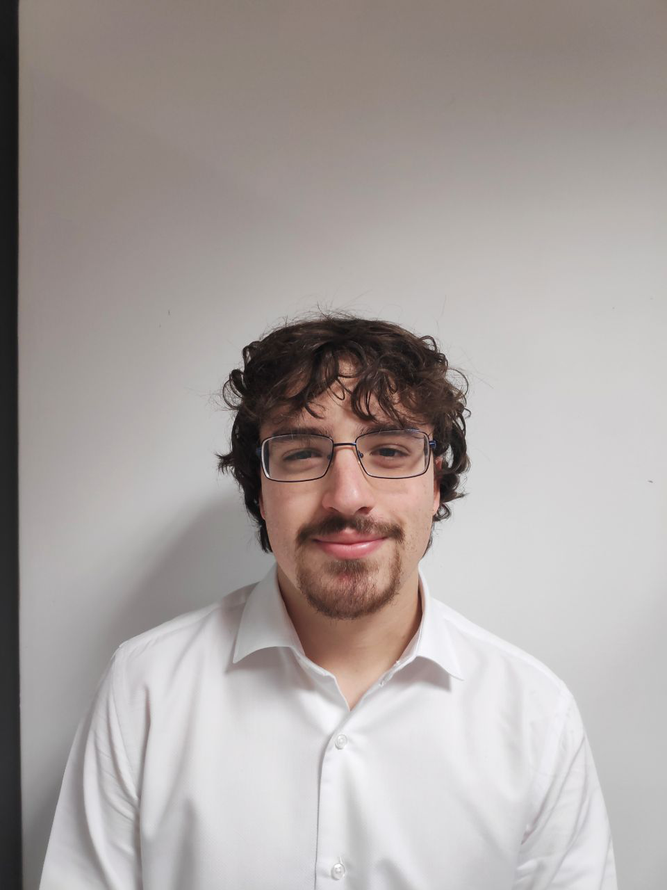
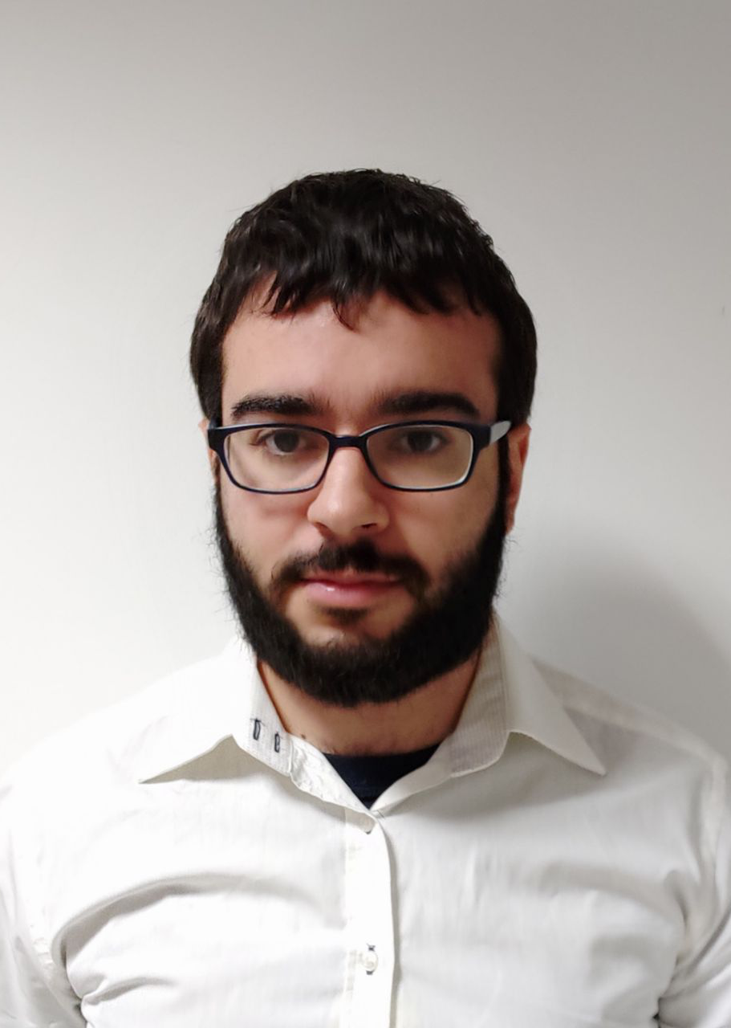
Team composition
Iván Pérez Piñero | Antonio Arenas Arenas | Miguel Santos Batista | Pablo Pazo Jiménez
Backend developer | Frontend developer | Full-stack developer | Backend developer
1
1.3
1.5
2
23.5
/
25.5
22
/
23
(h)
25.5
/
28
22
/
25
Notes:
Grupo 7

Slide 27
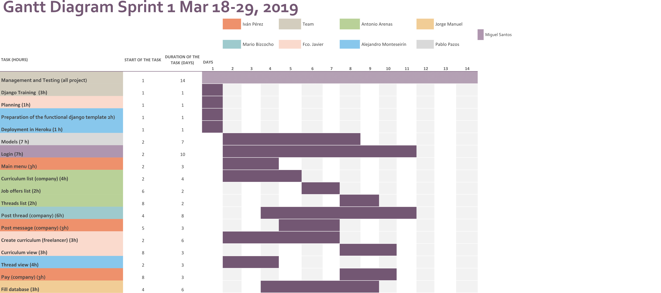
Development plan

Slide 28


Development plan
Management and Testing
All the team
Parallel task – all project
10
/
10

Slide 29
Development plan
Django training
All the team
Parallel task – all project
3
/
3

Slide 30
Development plan
Fco. Javier de la Fuente
Developer tasks

Slide 31
Development plan
Planning
Fco. Javier de la Fuente
1 day
2
/
2

Slide 32
Development plan
Create curriculum
Fco. Javier de la Fuente
6 days
6
/
5.5

Slide 33

Development plan
View curriculum
Fco. Javier de la Fuente
3 days – 2.5 hours
3
/
2.5

Slide 34
Development plan
Alejandro Monteseirín
Tasks

Slide 35
Development plan
Django template
Alejandro Monteseirín
1 day – 2 hours
2
/
2

Slide 36
Development plan
Heroku deployment
Alejandro Monteseirín
1 day – 2 hours
2
/
2

Slide 37
Development plan
Make payment
Alejandro Monteseirín
3 days – 4 hours
4
/
4

Slide 38
Development plan
Pablo Pazo
Tasks

Slide 39
Development plan
Model Building
Pablo Pazo
7 days – 12 hours
10.5
/
12

Slide 40
Development plan
Miguel Santos
Tasks

Slide 41
Development plan
Login and register
Miguel Santos
10 days – 10 hours

Slide 42
Development plan
Thread post
Mario Bizcocho, Miguel Santos
8 days (each)
8
/
8

Slide 43
Development plan
Mario Bizcocho
Tasks

Slide 44
Development plan
Thread post
Mario Bizcocho, Miguel Santos
8 days
8
/
8

Slide 45
Development plan
Antonio Arenas
Tasks

Slide 46
Development plan
Curriculum list
Antonio Arenas
4 days – 4 hours

Slide 47
Development plan
Job offer list
Antonio Arenas
2 days – 3 hours

Slide 48
Development plan
Thread list
Antonio Arenas
2 days – 3 hours

Slide 49
Development plan
Iván Pérez
Tasks

Slide 50
Development plan
Main menu
Iván Pérez
3 days – 6 hours

Slide 51
Development plan
Post thread reply
Iván Pérez
3 days – 4.5 hours

Slide 52
Development plan
View thread
Iván Pérez
3 days – 4 hours

Slide 53
Development plan
Jorge Manuel Molina
Tasks

Slide 54
Development plan
Fill database
Jorge Manuel Molina Domínguez
6 days – 5.5 hours

Slide 55
Contents
What is Aim Games?
Demonstration
Where we are
Team composition
Productivity control
Next steps

Slide 56
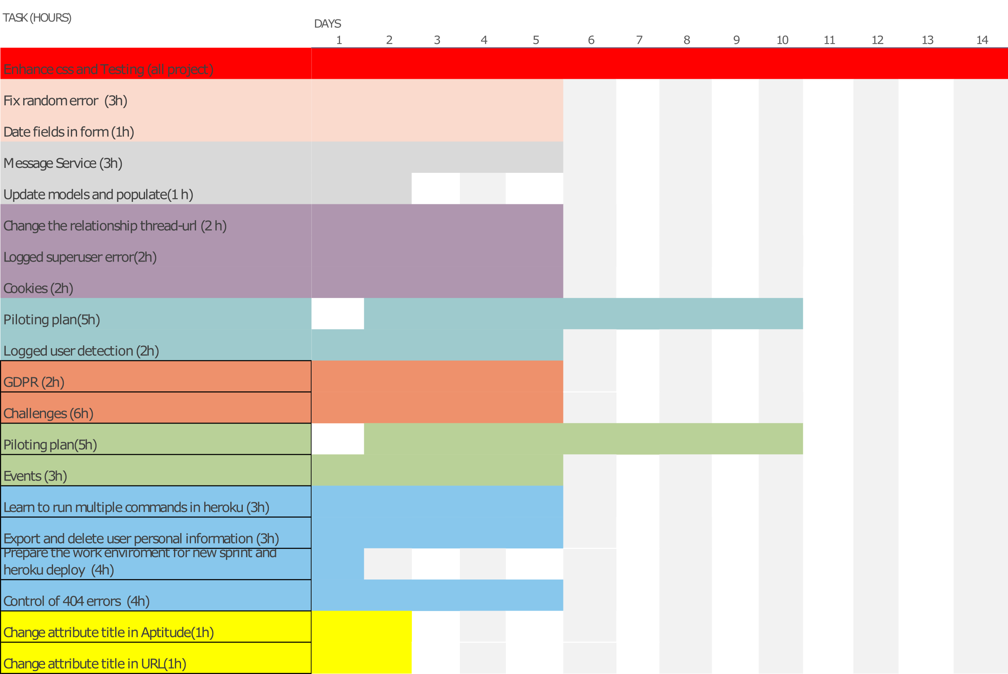

Next steps
56

Slide 57
Next steps
57

Slide 58


Piloting plan
Companies
TieSoft: Rafael Sánchez
Dual Mirror Games: Daniel Marín
Gunstar Studio: Rafael Casaucao
Base members
Alberto Sánchez
Vinnicios Thyago Dias
Francisco Sánchez
… Experience design testers
Anyone can join!
Around 50 members to be polled at street level
Notes:
Grupo 7

Slide 59

Thank you for your time!
If I have seen further it is by standing on the shoulders of Giants
- Isaac Newton
Summer in Mara (Chibig, Valencia, 2019)
Any questions?
Notes:
Grupo 7

